Slide 1


Predicting Wine Quality with Linear Regression
An analysis of physiochemical properties to forecast wine quality scores.
Puspita Baidya
ID:2102047
Meherin Jahan Jui
ID:2102055

Slide 2
Project Overview
This project aimed to develop a predictive model for wine quality using linear regression based on its physiochemical properties. We analyzed a dataset of red and white wines to understand attribute distributions and relationships.
Goal
Method
Evaluation
Predict wine quality using physiochemical properties.
Linear regression with QR decomposition.
RMSE and R-squared score.

Slide 3
Introduction: The Science of Wine Quality
Wine quality is a subjective metric influenced by complex chemical components. Our objective was to apply a linear regression model to predict wine quality scores using physiochemical properties from a dataset of red and white wines.
Interpretable Model
Quantitative Basis
QR decomposition provides a clear way to understand influential factors.
Model success measured using standard statistical metrics.

Slide 4

Model Evaluation
Root Mean Squared Error (RMSE): 0.7324
The model's predictions are, on average, off by 0.73 units on the wine quality scale.
This indicates a moderate level of prediction error.
R-squared (R² Score): 0.2965
The model explains 29.65% of the variability in the wine quality scores.
This suggests that while the model has some predictive power, a significant portion (~70%) of the variation remains unexplained.

Slide 5
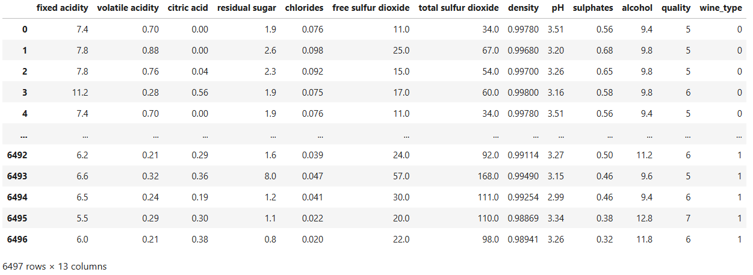
Methodology: Tools and Data
The analysis was performed in a Python environment using Jupyter notebook, leveraging libraries such as pandas, numpy,
and matplotlib.
6,497 samples, 13 columns
12 physiochemical features, 1 target (quality)
No missing data, clean for analysis
Quality scores: 3 to 9 (avg. 5.82)

Slide 6
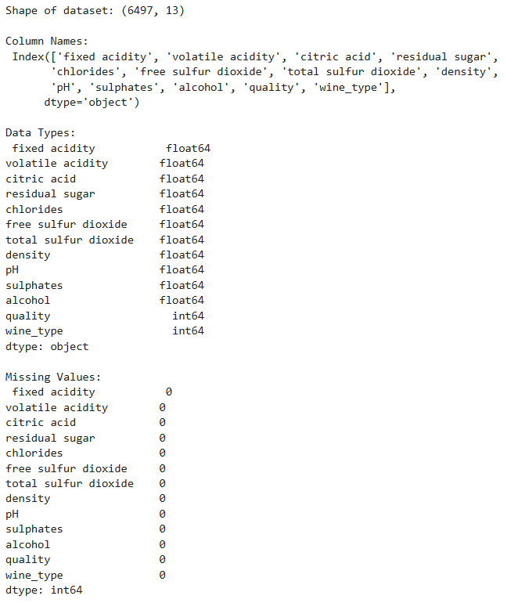

About our dataset :

Slide 7
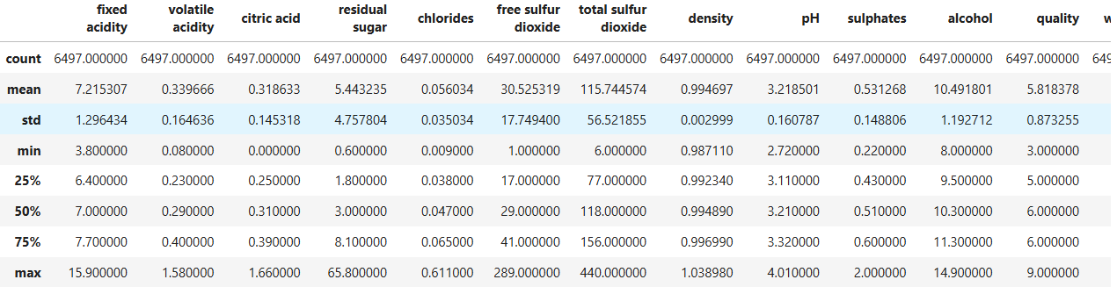
Descriptive statistics for all numeric columns

Slide 8
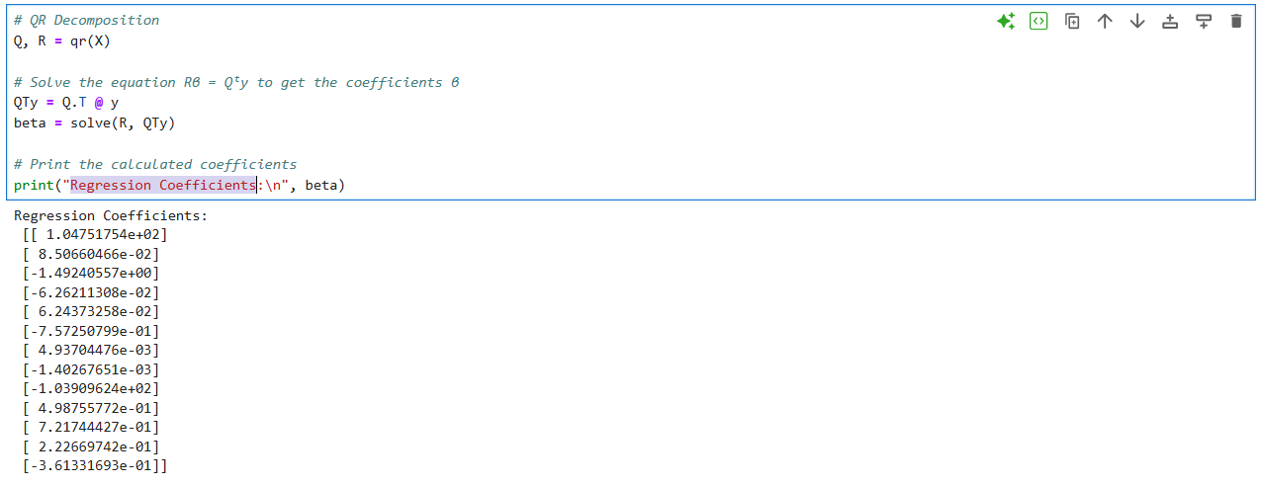
Regression Coefficients :
A positive coefficient means the feature increases the quality score.
A negative coefficient means the feature decreases the quality score.
The magnitude of the coefficient shows the strength of that influence.

Slide 9
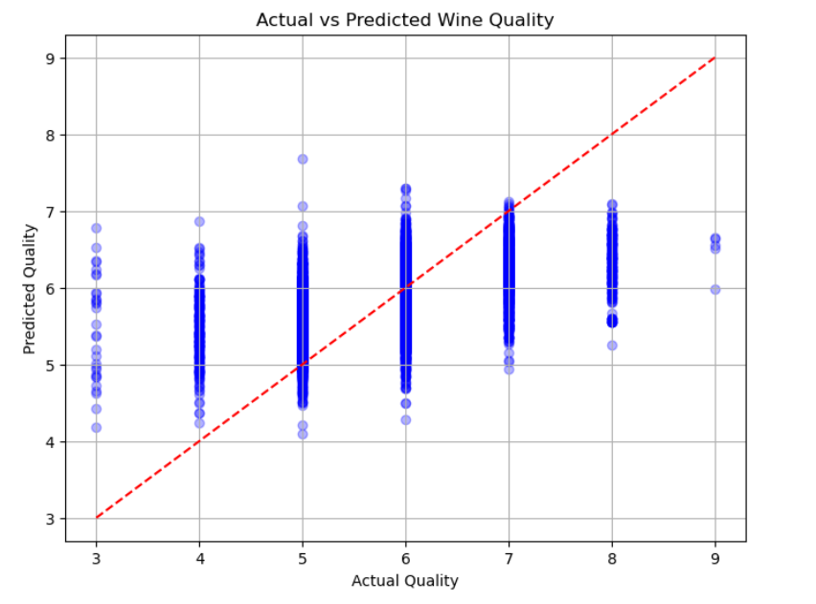
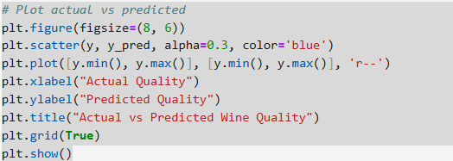
Plot actual vs predicted :
Area under the curve is 0.84

Slide 10
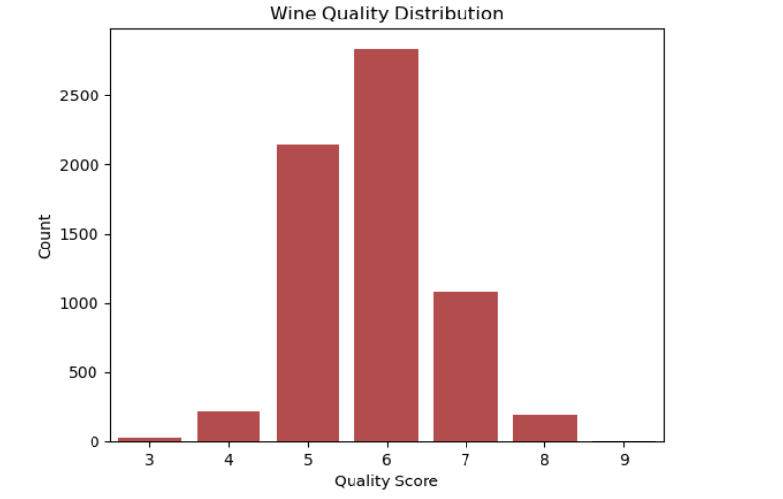
Plot wine quality distribution

Slide 11
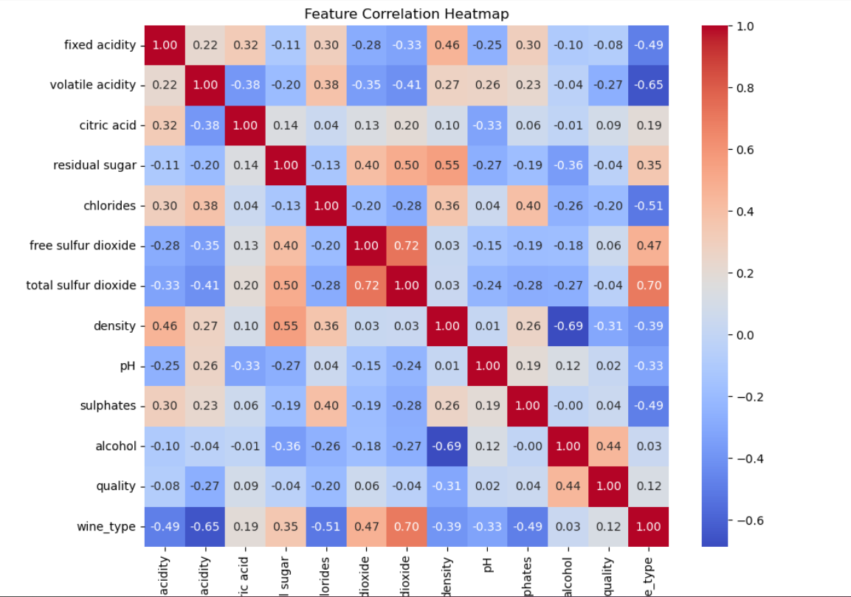
Compute and plot the correlation matrix

Slide 12
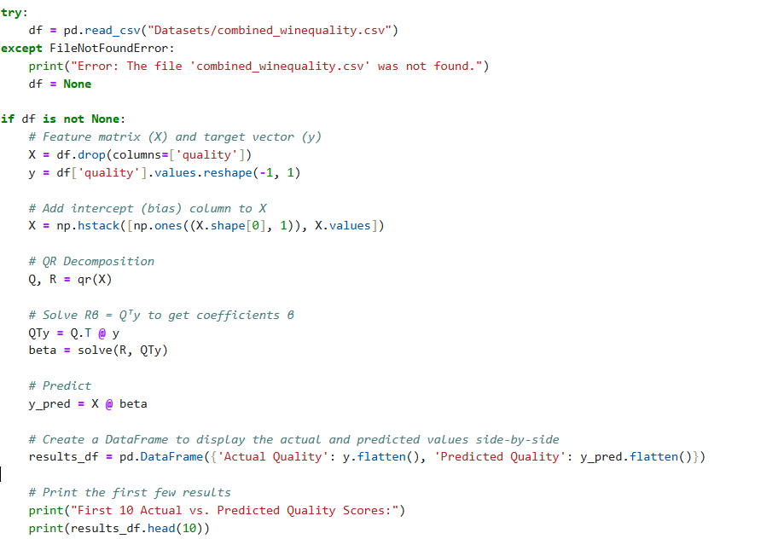
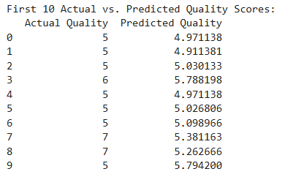

Actual vs Predicted Score :

Slide 13
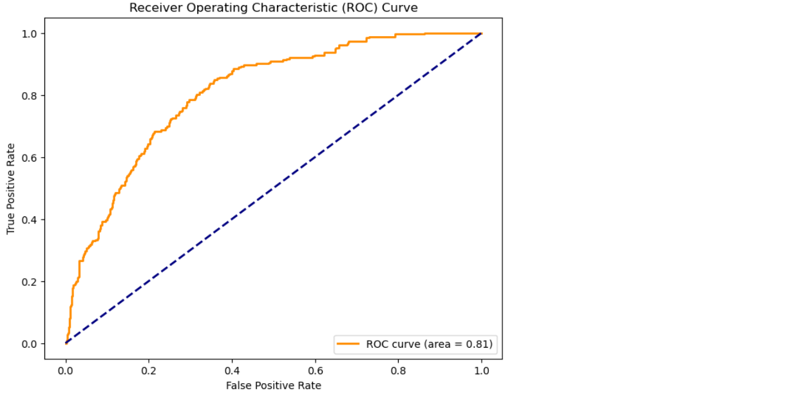

Slide 14


